Slide 1
Part 3: Knowledge Graphs

Slide 2
3. Knowledge Graphs - Overview
3.1 Knowledge Representation
3.1.1 Knowledge Representation
3.1.2 Semi-structured data
3.1.3 The Semantic Web
3.1.4 RDF - Resource Description Framework
3.1.5 Semantic Web Resources
3.2 Information Extraction
3.2.1 Keyphrase extraction
3.2.2 Named entity recognition (NER)
3.2.3 Information extraction (IE)
3.2.3.1 Hand-written patterns
3.2.3.2 Supervised machine learning
3.2.3.3 Bootstrapping
3.2.3.4 Distant supervision
3.2.3.5 Matrix Factorization
3.2.4 Taxonomy Induction
3.3 Knowledge Inference
3.3.1 Entity Disambiguation
3.3.2 Label Propagation
3.3.3 Link Prediction

Slide 3
3.1 Knowledge Representation

Slide 4
3.1.1 Representation of Semantics
Information retrieval and data mining aim at extracting and using semantics that is implicitly represented in documents and data
Alternatively, semantics can, and is, also explicitly represented and manipulated ☞ knowledge representation
Notes:
Historically speaking, the first information systems were based on explicit representation of the semantic models used. In business information systems, the data relevant to businesses was and is till today explicitely modelled in a structured data model, e.g. the relational data modelled. The data of the model is manipulated either manually, e.g. through manual entry, or processed by algorithms, e.g. for accounting. Only at a later stage with the advent of more computing power the use of implicitly represented models, as found in text documents, became feasible. The methods we have covered so far in this lecture fall in this later class. Interestingly, as algorithms become increasingly powerful in extracting information from unstructured content, the explicit representation of the extracted models and their use for further inference is now gaining in interest and importance.

Slide 5
Database Schemas
Schemas define data structures for databases
Relational database schemas, XML Schemas
Agreement on data structures
Well understood meaning of data values
Data consistency, e.g., integrity constraints
Optimizing query evaluation and data storage
e.g., indexing, query optimization
STUDENTID | NAME | COURSE
1234 | John | DIS
3456 | Bob | physics
2345 | Ann | DIS
Schema
Notes:
The probably most widely used approach for explicitly representing semantic models is through database schemas in database management systems. Schemas in database management systems play two important roles. First, they define data structures that capture that application semantics. They label data values with names (e.g., attribute names) that have well-understood semantics, or of which the semantics is provided by additional documentation. Second, by providing well-defined data structures and additionally imposing integrity constraints, database schemas additionally assure that data stored in the database remains structurally and semantically coherent. Exploiting knowledge on data structures also enables query and storage optimizations.
However, in many contexts of information management, e.g., on the Web, schemas are not always readily available, and imposing the use of schemas might be too rigid.

Slide 6


Data on the Web
Example: Searching biological data
Based on textual content of Web pages (e.g. Google)
Searching for data on "anglerfish"
Results will be precise
This seems easy, but the same for "leech"
Organism leech
Software: LeechFTP
Rock band: Leech
Authors: Leech
Protein sequences: …MNTSLEECHMPKGD…
Search for "257" …
Notes:
When publishing information on the web, no schemas are used, even if the published data could follow a regular data structure. Consequently, when searching the Web, search is content-based, e.g., using keyword queries.
This may work well for very characteristic search terms, such as illustrated for the example “anglerfish”, but might become problematic, when the search term has an ambiguous meaning, as illustrated for the example “leech”. Since a text search the type of the information that is searched cannot be specified – in our example we would need to specify that we meant the “leech” is an organism - the search algorithm cannot disambiguate the different potential meanings of the search terms. In the extreme case, if we would try to search for a numerical value as a search term, the results become essentially useless.
This suggest that the use of schema information for Web search could have some merit.

Slide 7
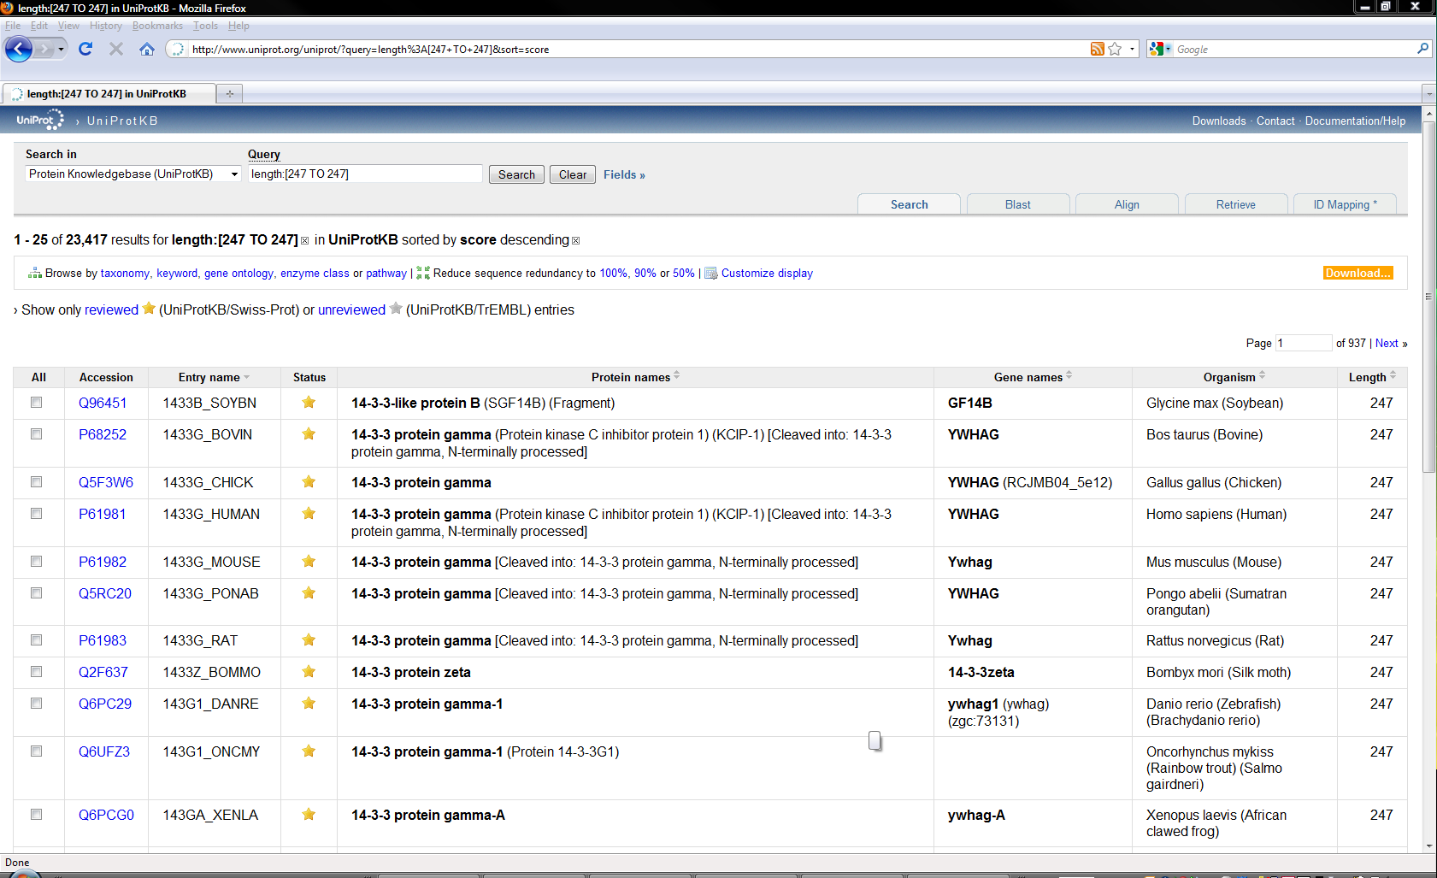
Using HTML to Structure Data
<tr>
<td style="width:0%"><input onclick="addOrAppendCart('Q96451')" class="cart-item" id="Q96451" type="checkbox"/></td>
<td style=""><a href="./Q96451">Q96451</a></td><td style="">1433B_SOYBN</td>
<td style="text-align:center;"><img src="../images/reviewed.gif" alt="" title="UniProtKB/Swiss-Prot = reviewed" /></td>
<td style=""><strong>14-3-3-like protein B</strong> (SGF14B) (Fragment)</td>
<td style=""><strong>GF14B</strong><br /></td><td style="">Glycine max (Soybean)</td>
<td style="text-align:right;white-space: nowrap;">247</td>
</tr>
<tr>
<td style="width:0%"><input onclick="addOrAppendCart('P68252')" class="cart-item" id="P68252" type="checkbox"/></td>
<td style=""><a href="./P68252">P68252</a></td>
<td style="">1433G_BOVIN</td><td style="text-align:center;"><img src="../images/reviewed.gif" alt="" title="UniProtKB/Swiss-Prot = reviewed" /></td>
<td style=""><strong>14-3-3 protein gamma</strong> (Protein kinase C inhibitor protein 1) (KCIP-1) [Cleaved into: 14-3-3 protein gamma, N-terminally processed]</td>
<td style=""><strong>YWHAG</strong><br /></td><td style="">Bos taurus (Bovine)</td><td style="text-align:right;white-space: nowrap;">247</td>
</tr>
<tr>
<td style="width:0%"><input onclick="addOrAppendCart('Q5F3W6')" class="cart-item" id="Q5F3W6" type="checkbox"/></td>
<td style=""><a href="./Q5F3W6">Q5F3W6</a></td><td style="">1433G_CHICK</td>
<td style="text-align:center;"><img src="../images/reviewed.gif" alt="" title="UniProtKB/Swiss-Prot = reviewed" /></td>
<td style=""><strong>14-3-3 protein gamma</strong></td><td style=""><strong>YWHAG</strong> (RCJMB04_5e12)<br /></td>
td style="">Gallus gallus (Chicken)</td><td style="text-align:right;white-space: nowrap;">247</td>
</tr>
HTML table layout to structure the data!?
Notes:
A typical approach to handle data in the Web is to publish documents with a regular structured layout, e.g., using HTML tables. In this way a context is provided that allows to correctly interpret data values. When inspecting the source code of a typical HTML page publishing structured data, we recognize that it might be difficult to automatically process such a page and to correctly interpret the data contained in it. Such processing might be very involved and error-prone, even more so as in the context of editing Web page layout no mechanism assures that the intended page structure is correctly maintained. The problem is that a document layout language, such as HTML, never has been conceived to specify semantics of data.

Slide 8

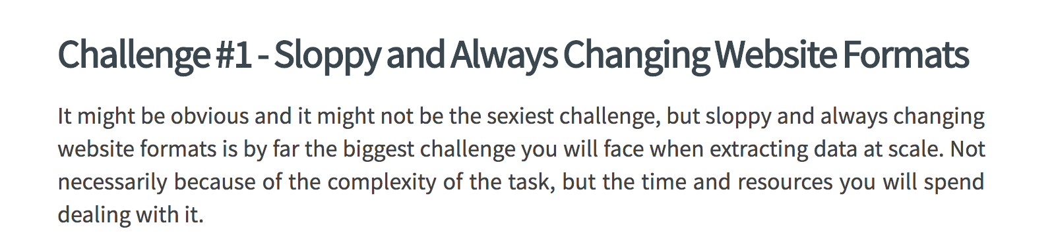
Web Scraping
Encoding data semantics through layout is a bad idea
Generations of “Web scrapers” experience this
https://www.zyte.com/blog/price-intelligence-web-scraping-at-scale-100-billion-products/
Notes:
The widely adopted approach of publishing data through HTML documents has given rise to a whole industry of web scraping. It is of interest to gather data from the Web, for example, for comparison of prices from ecommerce sites. However, experience shows that this is a complex and time-consuming task. It is also a never-ending task as formats of Web sites can change at any time and there exist no standards on how the data is represented in HTML.

Slide 9
Application-specific Markup
Limitations of HTML
Structure of data expressed as layout: <tr><td> leech </td><tr>
Semantics of data hard to analyse and difficult to share
No schemas, no constraints
Making the meaning of data explicit
SwissProt: <Species> leech </Species>
EMBLChange: <Organism> leech </Organism>
Embedding of schema information into the data
Application-specific markup (tags)
Notes:
Therefore, an alternative approach for specifying the meaning of data contained in Web documents, has been conceived. As for HTML, the approach is based on the idea of using tags, i.e., markup text that associates parts of a document with a name. However, instead of using tags to provide layout instructions (e.g., a table format), tags are used to provide domain-specific meaning to data contained in a document. For example, markup can be used to specify that a specific name (such as leech) denotes an organism. This approach of using markup is widely used in different contexts. For example, email formats contain different standard markups to indicate the meaning of different parts of a mail. In the Web, the use of markup has found wide-spread adoption through the XML format. XML generalizes the markup approach from HTML to allow applications to specify their application-specific tags and to embed them into documents. If you are not familiar with XML, it would be helpful to refresh your knowledge on XML and schemas in XML.

Slide 10
3.1.2 Semi-structured Data
Data that embeds schema information (through tags, markup etc.) to explain the meaning of data values and to relate different data values (e.g. hierarchically) = semi-structured data
No predefined data structure, no schema required!
Examples of semi-structured data
Email
Microformats (e.g. hCard)
JSON
XML (Extensible Markup Language)
Notes:
Data that contains embedded schema information, such as tags or markup, is generally called semi-structured data. Semi-structured data allows to indicate the meaning of data values, as in structured data with schemas, without necessarily requiring predefined schemas. This combines flexibility of modelling with the ability to specify meaning. The fact that semi-structured data does not require schemas, does not imply that we cannot define schemas for semi-structured data. XML is an example of this. We can have XML structured documents without schema, so-called well-formed XML documents, but define in addition schemas for XML (document type definitions, so-called XML DTDs). Documents that follow such a schema are then called valid XML documents.

Slide 11
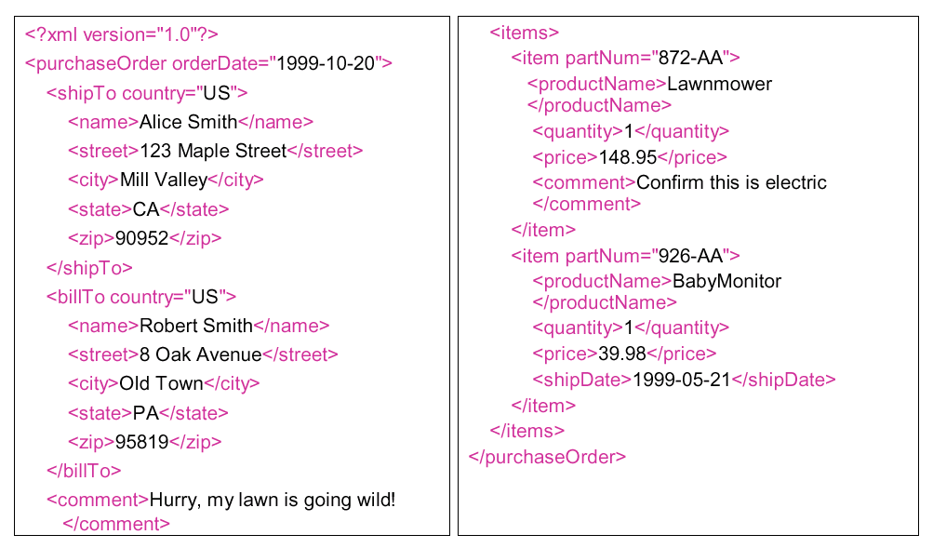
XML – a Document Markup Language
Notes:
Originally XML has been conceived as a document model. In this example of an XML document, we can clearly see the document nature of XML. An XML document consists of hierarchically nested tags which enclose textual content.

Slide 12
XML- a Semi-structured Data Model
2002-13-12
orderDate
purchaseOrder
shipTo
billTo
comment
items
Hurry …
name
street
city
state
zip
124-AA
item
item
partNum
partNum
productName
quantity
price
comment
AliceSmith
Mill Valley
CA
90952
123 Maple Street
Lawnmower
1
152,99
confirm order
Notes:
However, the same XML document can also be viewed as structured data. An XML parser would typically generate a hierarchical data structure as illustrated. This explains why we can understand XML also as a data model, more precisely a semi-structured data model, as it embeds schema information directly into the data.

Slide 13
Schema-less data
Benefits of schema-less data
Increased flexibility
e.g., dynamically adding or dropping structural elements such as attributes
Self-contained data
e.g., context (schema information) directly encoded into data (markup)
Drawbacks
Loss of consistency
Certain optimizations not feasible
Notes:
Semi-structured data can be schema-less. This has significant advantages for applications that do not know the structural elements in advance. For example, often it is helpful if new types of attributes can be added in a database as application requirements evolve. Another advantage is that by embedding schema information into the data, data can be interpreted without requiring additional context information in the form of database schemas. This can be useful in applications where data is exchanged.
Having no schema has however also its drawbacks as the additional flexibility also can be at the detriment of data consistency. Applications might, for example, not be able to properly process attributes that have been arbitrarily added. Also many optimizations that rely on the availability of a schema, and on the assumption that the schema is stable, cannot be applied.

Slide 14

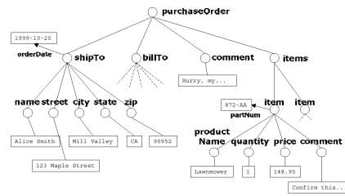
Serialization: Data and Documents
Document = medium for
exchange of information
Communication
Information system 1
Information system 2
Notes:
The duality of XML, being a document model and a data model at the same time makes it particularly suitable for applications that exchange data over communication networks. For every data collection or database that is represented in XML there exists a canonical encoding into a text (document). The encoding is called serialization. Since documents are sequences of symbols, they can be naturally exchanged over communication networks. There exist many other similar models for serializing data into documents. Recently JSON has become widely used for exchanging data among applications and has to a certain extent substituted XML in this role in many contexts. However, JSON is less suited for applications that enrich natural language text with structured data.

Slide 15
Semi-structured data …
is always schema-less
always embeds schema information into the data
must always be hierarchically structured
can never be indexed

Slide 16
Why is XML a document model?
It supports application-specific markup
It supports domain-specific schemas
It has a serialized representation
It uses HTML tags

Slide 17
Serialised vs. Semi-structured Data
Many of the semi-structured data models have been conceived to structure text documents (XML) or serialise data (JSON)
However, there exist semi-structured data models that are not based on a serialized representation
→ knowledge graphs
Notes:
Serialisibility and semi-structured data are concept that are strongly correlated but not the same. Many of the semi-structured data models, like XML and JSON, have been introduced to either enrich documents with data semantics, or to encode data in a serialized format. However, it is perfectly possible to define a semi data model, that does not necessarily aim at a serialized representation. Knowledge graphs are an example for this - though they of course also can be and are serialized. Knowledge graphs have been conceived to provide a flexible way to model data and capture semantics. We will next review the development of this concept.

Slide 18

3.1.3 The Semantic Web
User-defined markup (schemas): provides possibility to share interpretation of data across various applications
Different databases – Different schemas
SwissProt: Find <Species> leech </Species>
EMBLChange: Find <Organism> leech </Organism>
Problem: Semantic Heterogeneity → Semantic Web
Information System 2
Data 2
Interpretation 2
Information System 1
Data 1
Interpretation 1
Notes:
XML provides a framework to encode data on the Web in a standardized fashion, to deal with irregular Web data structures and to exchange Web data among information systems. Thus, it is an approach to address syntactic heterogeneity on the Web.
The markup used in XML can be interpreted by applications. This enables automated processing of Web data. However, for properly interpreting the markup, semantic heterogeneity needs to be addressed as well. The same concepts can ^represented in different application contexts differently, e.g., by using different terms to denote the same meaning. This is a major obstacle to enable interoperability on the Web and indeed in industry this is considered as one of the major problems in the use of information technology. Already in 2010, Mike Brodie at the time at GTE, estimated that the total cost of semantic integration world-wide amounts to 1 trillion$ / year. Very likely, this figure has in the meantime increased.

Slide 19
The Vision of W3C: Semantic Web
The Semantic Web is an extension of the current Web in which information is given well-defined meaning, better enabling computers and people to work in cooperation. The mix of content on the Web has been shifting from exclusively human-oriented content to more and more data content. The Semantic Web brings to the Web the idea of having data defined and linked in a way that it can be used for more effective discovery, automation, integration, and reuse across various applications. For the Web to reach its full potential, it must evolve into a Semantic Web, providing a universally accessible platform that allows data to be shared and processed by automated tools as well as by people. The Semantic Web is an initiative of the World Wide Web Consortium (W3C), with the goal of extending the current Web to facilitate Web automation, universally accessible content, and the 'Web of Trust'.
(http://www.w3.org/2001/sw/Activity)
Notes:
In order to address the problem of semantic interoperability and thus enable automated processing of Web data, the W3C initiated the “Semantic Web” initiative. The Semantic Web is a framework that builds on Web technology, including the XML framework and extends it with technologies that facilitate semantic interoperability.

Slide 20
Three Ways to Overcome Semantic Heterogeneity
Standardization: agree on common user-defined markup (schemas)
great if no pre-existing applications
great if power player enforces it
Translation: create mappings among different schemas and databases
requires human interpretation and reasoning
mappings can be difficult, expensive to establish
Annotation: create relationships to agreed upon conceptualizations
requires human interpretation and reasoning
annotation can be difficult, expensive to establish
reasoning over the conceptualization can provide added value
Notes:
There exist three basic approaches to tackle the problem of automating semantic processing of the data on the Web:
Standardization avoids the problem of semantic heterogeneity a priori. This approach is used when there exists already (historically) a wide agreement on the structure of relevant data and their interpretation. For example, terminology in the financial industry is largely standardized, and therefore it is not a major problem to produce agreed upon formal specifications of such terminology and corresponding schemas to represent the data. This is even more the case as there exist in this type of business environment typically strong players that can enforce the standards.
Translation or mapping between different schemas and databases is the second possibility to establish semantic interoperability. This is the approach that has been extensively adopted for data integration problems in relatively small and controlled domains, such as inside businesses and organizations. The requirements in these domains are typically changing not too quickly, thus much effort can be invested into developing the necessary mappings in order to properly map data from one representation into another, or to map data from multiple representations into one common global representation.
The third possibility is slightly different from the second: instead of engineering mappings between heterogeneous schemas for each integration problem, one first agrees on a common conceptualization of the domain, covering relevant aspects for a large class of applications. This conceptualization is normally called an ontology and is assumed to be application independent. Since ontologies have a formal representation, they are machine-processable. Once such an ontology is in place, existing information system can relate their structural elements for expressing certain concepts (e.g., element names) to concepts from the ontology. This then ideally enables other applications to properly interpret the contents of the information system. In addition, ontologies in the general case should include reasoning capabilities, which would permit to use not only hard-coded, or pre-canned knowledge, e.g., in form of explicitly relating concepts from an information system to the ontology, but also to derive new knowledge by combining existing knowledge.
This differentiation among different approaches to semantic interoperability has been standardized: according to ISO 14258 (Concepts and rules for enterprise models), there are three basic ways to relate entities together:
Integrated approach. There exists a common format for all models. This format must be as detailed as the models themselves. The common format is not necessarily a standard but must be agreed upon by all parties in order to elaborate models and build systems. (-> Standardization)
Federated approach. There is no common format. In order to establish interoperability parties must accommodate on the fly. Federated approach implies that no partner imposes their models, languages and methods of work. This means they must share a common ontology. (-> Translation)
Unified approach. There exists a common format but only at a meta-level. This meta-model is not an executable entity as in the case of the integrated approach but provides a way for semantic equivalence to allow mapping between models. (-> Annotation)

Slide 21
Mapping: Three Approaches
1. Standardization
Mapping through standards
2. Mapping
Direct mapping
3. Ontologies
Mediated mapping
EDIFACT
EDIFACT
FIBO
Notes:
Conceptually there exist three principal approaches of how to address semantic heterogeneity. A first approach is to map all the models to one common global model. This approach is taken with standardization. For example, EDIFACT (https://www.unece.org/cefact/edifact/) is an international standard that models all concepts that are commonly used in business and trade. For exchanging information, the information systems map their data to EDIFACT and can thus share their data with other information systems.
A second approach consists of constructing directly a mapping among two information systems, without using any additional, shared knowledge in form of standards or ontologies
A third approach is to relate the model of an information system to a common model, frequently called ontology, and use this mapping to construct a direct mapping among the different models used in the information systems. . For example, in the financial domain there exists a standard reference ontology called FIBO (https://fib-dm.com/finance-ontology-transform-data-model/)

Slide 22
Direct Schema Mapping
Assume all data represented in canonical data model (e.g. relational)
detect correspondences (schema matching)
resolve conflicts
integrate schemas (schema mapping)
Mappings are frequently expressed as queries (e.g. SQL Query)
Notes:
Creating direct mappings among information systems has been widely applied for mapping data that is stored in relational, object-oriented and XML databases, where the model is represented as a database schema. The problem is known as the schema mapping problem. Given two schemas of databases, first schema elements are identified that are likely to correspond to each other, i.e., that are likely representing the same real-world aspect. This can be done by using many types of analysis using structural and content features of the database schema and the database. Tools for supporting these steps are called schema mapping tools. Once this step is performed some conflicting correspondences may occur, e.g., mapping some concept in one schema to two different ones in the other. These need to be resolved typically through decisions taken by humans. Once the correspondences are consistent, mappings can be automatically derived. The mappings are typically expressed as queries of the data manipulation language.

Slide 23
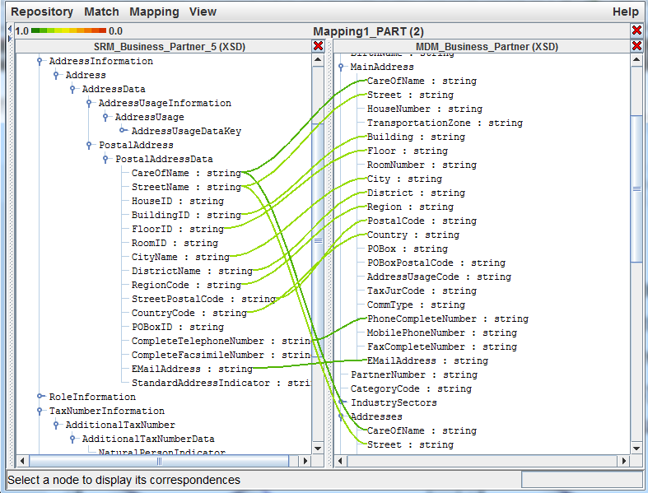
Schema Matching Tools
Notes:
This screenshot shows a schema matching tool that maps between different XML schemas. The lines indicate which attributes might be related to each other. One can easily see a lot of conflicts where the same attribute corresponds to multiple attributes in the other schema.

Slide 24
Mediated Mappings
MetaData (Shared Ontologies)
Organism
ISA
Fish
is-instance-of
Annotator 1
is-instance-of
Annotator 2
http://www.bio.com/SP.xml:
<SP_entry>
<ID>CBPH_LOPAM</ID>
<Authors>Roth</Authors>
<Organism>
Lophius americanus (American goosefish) (Anglerfish).
</Organism>
<Sequence>
MKQICSIVLL …
</Sequence>
</SP_entry>
http://www.bio.com/EC.xml:
<EC_entry>
<ID>
LAJAFGI_5; VRT
</ID>
<Species>
Lophius americanus (anglerfish)
</Species>
<SQ>
Sequence 1 BP
</SQ>
</EC_entry>
Data 1
Data 2
Notes:
This simple example illustrates of how ontologies can help to increase semantic interoperability and how new knowledge can be generated by inference. Take the earlier example of biological databases. These can use different schemas to represent the same or related facts. For example, System 1 uses the term Organism to denote an organism, and System 2 uses the term Species to do the same. Two annotators, who share the same ontology, now inspect the document and each of them associates the elements with terms taken from the ontology. So, Annotator 1 decides that the element Organism corresponds to information related to an organism, whereas annotator 2 concludes by analyzing the content that the element is related to information about a fish and annotates correspondingly. The annotation can be perfoermed by adding an is-instance-of relationship. At this point, the facts that both annotators used the same ontology, and that reasoning is possible in this ontology come into play. Since in the ontology a Fish is a sub-concept of Organism (a fact represented formally by an ISA relationship in the ontology) an automated processing tool (e.g., for searching for information) can exploit this relationship and correctly identify for a request for information on Organisms in both databases the related elements.

Slide 25
Ontologies
Ontologies are an explicit specification of a conceptualization of the real world (Gruber, 1993)
Ideally
different information systems agree on the same ontology
relate their model/schema/data elements to the ontology
mapping can be constructed via the ontology
Requires agreement on the conceptualization of the real world!
Information System 2
Ontology
Data 2
Interpretation 2
Information System 1
conceptualization
Data 1
Interpretation 1
Notes:
Thus, ontologies provide a “proxy representation” for the real world, to which the interpretation of data in information systems refers to and thus provide an interpretation of the data in an information system that can be automatically processed. In order to realize this approach, different technical challenges need to be addressed.

Slide 26
Creating Ontologies
Different approaches to create ontologies
Ontology engineering
Manual effort
Tools for editing and checking consistency
Automatic generation of ontologies
From large document collections or existing structured data sources
Notes:
In order to make ontologies available, they need to be constructure. This is the practice of ontology engineering. Ontology engineering is largely a manual process, that can be supported by tools for checking consistency and facilitating editing. Ontology are often not only constructed once but need to be maintained to stay up to date with developments in a given domain. For example, important entities, like organizations, can change, technology evolves etc.
More recently, also automated methods based on information extraction from large document collections are becoming available to that end. We will see later examples of such methods using statistical and machine-learning approaches.

Slide 27
Modeling and Encoding of Ontologies
Issues
Modeling primitives and their semantics
what does an arrow mean?
what does "instance-of" mean?
what does ISA mean?
Standardized encodings of the model
Into document language (XML, HTML)
Enriching document content with semantic markup
Notes:
For representing ontologies, a mathematical model for the constructs used in modelling the application domain is required, as well as a data model to represent such a model in a data management system. The choice of the formal mathematical is important, as the model should at the same time be expressive to capture a wide range of real-world aspects, but at the same time understandable by the user, have a well-defined semantics and relevant reasoning capabilities.
Finally, the models should also provide a serialized representations, e.g., by encoding them in standard document languages such as XML or HTML. Such encodings can at the same time be used to enrich text documents with semantic annotations.

Slide 28
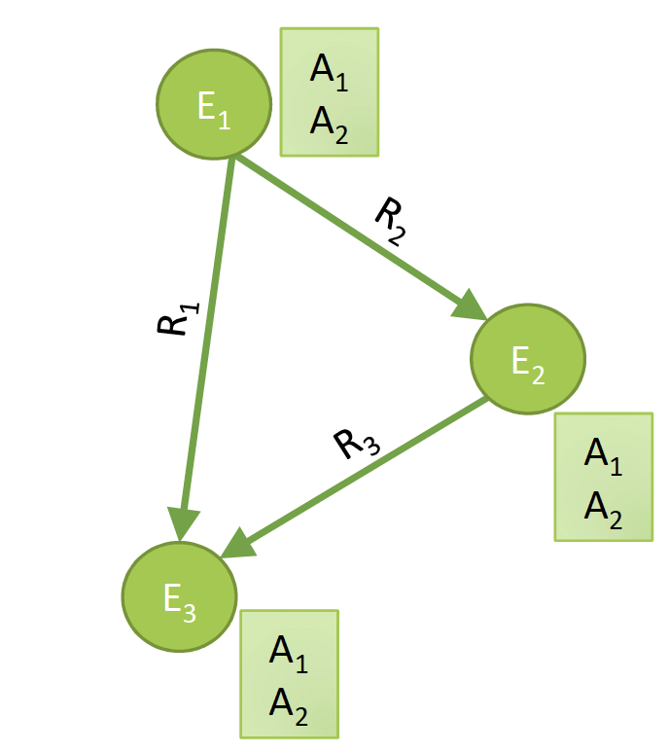
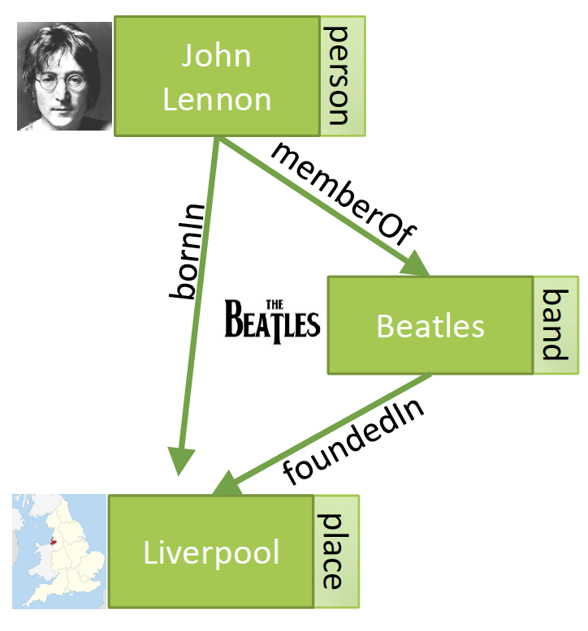
Knowledge Graphs (Google 2012)
Notes:
One model for representing ontologies that has gained large popularity recently are knowledge graphs. They are based on a graph-based representations of basic first order logic constructs, entities, which are elements from given domains, relationships, which are binary relations and attributes which are relations among entities and values from a standard data structure.

Slide 29
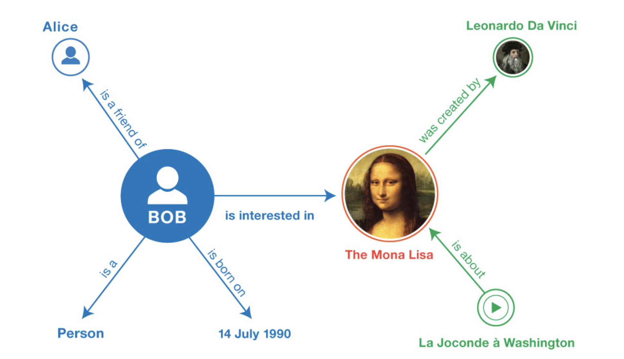
RDF – Resource Description Framework (W3C 2004)
Notes:
In fact, long before knowledge graph have become popular, a similar model has been developed by the W3C, the Resource Description Framework. It has the same basic concepts as knowledge grpahs, together with some additional modeling primitives. We will provide an overview of RDF in the following.

Slide 30
Entity-Relationship Model
The Entity Relationship Model: Toward a Unified View of Data, Peter Pin-Shan Chen, 1976
Notes:
The approach of using concepts from first order logic for modeling reaches however far back in history. In the area of database management systems, the entity-relationship model has been established as a standard approach for data modeling already in 1976. The main difference is in the intended use of the model at the time. It was used to provide a conceptual model of an application domain and then to derive in a mostly automated way a database schema (in other words data structures) in the data model supported by the target database management system. This model typically is the relational data model.

Slide 31
Model Requirements for Ontologies
 | HTML | XML | RDF | OWL
Simplicity | + | + | + | +
Exchangeability | + | + | + | +
Non-intrusive annotation | + | - | + | +
Domain-specific vocabularies | - | + | + | +
Modeling primitives | - | - | + | +
Reasoning capabilities | - | - | - | +
"separate structure from presentation"
"separate interpretation from structure"
Notes:
We have identified so far different models for representing information in the Web, HTML, XML, and RDF. They all serve specific purposes and exhibit characteristic properties. This table summarizes those properties and highlights interesting “separation of concerns”. RDF and OWL, an extension of RDF to provide more reasoning capabilities separate the concern of reasoning at a semantic level from structuring of data. XML has been serving to separate the concern of structure of data, from providing layout information to documents. The table highlights related design objectives.
Simplicity: the success of the Web was always founded on the principle of simplicity of concepts to encourage wide-spread use. Early version of ontology models, such as CyC, where partly also not widely adopted due to their complexity. Similarly, XML was developed as a simplification of a predecessor standard, called SGML, which was more complex.
Exchangeability: Since the Web is a communication environment, any kind of data that is processed must be easily exchangeable. This is what motivated the use of XML as a data representation format in the first place and should apply for ontology models as well.
Non-intrusive annotation: machine-processable knowledge required for the interpretation of data will be associated with the data typically a-posteriori. Also there does not always exist a unique interpretation for the same data. Therefore, any attempt to encode the knowledge required for interpretation directly into the data is not practical. This excludes, for example, the approach to use XML elements for annotation.
Domain-specific vocabularies: an ontology model must provide a mechanism that permits to introduce vocabulary or terminology that is specific to a domain, in other words the possibility to specify schemas for different domains.
Modeling primitives: since an ontology model will be used in many different contexts, they have to offer a sufficiently rich set of possibilities to model complex structures and relationships. There exists a rich experience in modeling (e.g., from data modeling in databases with the entity-relationship models) that can be applied to ontology models.
Reasoning Capabilities: even simple forms of reasoning within the ontology layer can make the interpretation of the data much more powerful and thus automated processing of data in the Semantic Web.

Slide 32
W3C Web architecture
Trust
Proof
Signature/Encryption
OWL
RDF/RDFSchema
XML/DTD
Namespaces
URI
Unicode
Notes:
This figure depicts the architecture adopted by the W3C. It standardizes different layers of information processing. The lowest layer is concerned with identification and encoding as basic building blocks for building data models. XML together with the namespace mechanism is the data modeling framework. RDF and its extension OWL enable semantic interpretation and exchange. The levels of proof and trust are still rather hypothetical.

Slide 33
An ontology …
helps to separate layout issues from the structural representation of data
provides a common syntactic framework to represent standardized domain models
can be used as a mediation framework for integrating semantically heterogeneous databases

Slide 34
3.1.4 RDF - Resource Description Framework
How to produce a serialized representation of a graph?
How to describe complex entities?
How to incorporate schema information into a knowledge graph?
How to reason about the knowledge graph?
Notes:
RDF has been designed by the W3C with a number of different questions in mind. We will now provide a step-wise introduction into the modeling framework.

Slide 35
RDF Model
RDF (Instances)
Statements about Resources (addressable by an URI) and literals (XML data)
Statements are of the form: subject property object
Like simple natural language sentences
RDF statements are themselves resources (reasoning about RDF)
Properties define relationships to other resources or atomic values
RDF-Schema
Data model to specify schemas for RDF instances
Which properties are applicable for which objects with which subjects
Defines “grammar” and “vocabulary” for semantic domains (ontology language)
Relation RDF vs. RDFS comparable to well-formed vs. valid XML
Notes:
RDF is a standard supported by the W3C (http://www.w3.org/RDF/) to represent metadata. It is a graph-oriented data model used to annotate XML documents. RDF consists of two parts: a language for representing metadata instances (RDF), which allows to annotate Web resources with statements. The Web resources are addressed by Universal Resource Identifiers (URI), of which URL’s are the most important example. Thus, any Web document or part of it can be annotated. The second part of the RDF standard is a language for specifying schemas for RDF Instances. This language enables specification of the vocabulary and grammar that is used for forming statements for annotation. Since RDF statements can be created also without using RDF schemas, RDF is a semi-structured data model, similar to XML.
The RDF model is like the entity-relationship (ER) model. Entities correspond to resources and relationships correspond to properties. The main difference is that RDF requires that relationships are directed : the resource from which the (directed) relationship emerges is assigned a property with a value to which the relationship points. This reflects the intention to use RDF to associated metadata (the value) with data (the source of the relationship). Sample RDF applications include PICS (annotating documents with information on the suitability of the content for certain groups, e.g., like the movie rating system) and Dublin Core (annotating documents with basic bibliographic information.
It is important to understand that the syntax of RDF and its encoding into XML is well-specified, but that the semantics RDF is only specified in a « semi-formal » manner. This introduces certain ambiguities for applications interpreting RDF statements.

Slide 36
RDF Statements Example
http://www.doc.ch/
created by
John Smith
Subject a resource
Predicate a property
Object a resource or value
Form 1:
Statement
http://www.doc.ch/
<rdf:RDF>
<rdf:Description about="http://www.doc.ch/">
<dc:Creator> John Smith</dc:Creator>
</rdf:Description>
</rdf:RDF>
dc:Creator
John Smith
Form 3: XML Document
Form 2: Directed Graph
Notes:
The basic constituent of RDF is an RDF statement. We can view RDF statements in three different ways: (1) like natural language sentences, where the subject is a URI (uniform resource identifier) and the object can be either a URI or a String; (2) as directed graphs, where the subject and object are represented as nodes (an ellipsis is used to represent resources identified by a URI and rectangles to represent literals as atomic XML values) and the predicate is represented as directed link , or (3) as XML documents where the RDF statement is encoded into XML format. The graph representation is suitable for visual presentation and reasoning, whereas the XML representation is used for exchange and storage.

Slide 37
RDF Syntax
Many syntactic varieties possible
Basic form
Starts an RDF-Description
Subject (resource identified by URI)
<rdf:RDF>
<rdf:Description about="Person://1234/1" s:Date="1.1.02">
<s:Creator>John Smith</s:Creator>
<s:createdWith rdf:resource=“http://www.w3c.org/amaya”/>
</rdf:Description>
</rdf:RDF>
Literal
Resource
Attribute
Element
Attribute
Properties
Object
Notes:
For encoding RDF statements into XML there exist several syntactic variations, which can make the reading of RDF documents sometimes rather difficult. Here we summarize the different variants. The basic pattern of encoding is as follows: the subject is represented by an XML element called rdf:Description. This element is the root of the document fragment representing the RDF statement. In the content of the element, one finds one or more predicates, represented by XML elements, e.g., s:Creator. The content of this XML element in turn represents the object of the RDF statement. If the object is not a literal, one can alternatively represent the object as an attribute of the predicate element. Also, both the predicate and the object can be encoded into the element representing the statement, as it is shown for s:Date predicate.

Slide 38
Typing Resources
Resources can be associated with a type by using rdf:type (a special property)
rdf:type
http://www.doc.ch/
Document
dc:Creator
<rdf:RDF>
<rdf:Description about="http://www.doc.ch/">
<rdf:type>Document</rdf:type>
<dc:Creator> John Smith </dc:Creator>
</rdf:Description>
</rdf:RDF>
John Smith
<rdf:RDF>
<dc:Document about="http://www.doc.ch/">
<dc:Creator> John Smith </dc:Creator>
</dc:Document>
</rdf:RDF>
abbreviated syntax
Notes:
RDF allows us to categorize resources into different classes (typing). For that purpose, one associates with the resource that should be categorized another resource, that represents the category, using a special RDF property rdf:type. We will see later, when introducing RDF schema, what are possible uses of the type statement. With respect to encoding, the type property can either be represented explicitly like any other property, or one can use a special abbreviated syntax, where the name of the type becomes the element name of the element representing the statement.

Slide 39
RDF Complex Values
Use an intermediate resource
http://www.doc.ch/
<rdf:Description about="http://www.doc.ch"> <dc:Creator> <rdf:Description about="Person://1234/1"> <name>John Smith</name> <email>john.smith@epfl.ch</email> </rdf:Description> </dc:Creator> </rdf:Description>
dc:Creator
Person://1234/1
name
email
John Smith
john.smith@epfl.ch
Notes:
Associating a subject with a property whose value is a simple object is the simplest form of a statement. In general, the value of a property (the object of the statement) may be a complex statement itself, representing a complex data structure. In order to represent such complex object values a new intermediate resource is created - in the example Person://1234/1 - to which different properties are associated. Note that this is different of directly associating these properties with the subject of the overall statement, http://www.doc.ch/ in the example (why?).
In the XML encoding such a complex object value can be represented by directly inlining the complex object into the content of the statement.

Slide 40
RDF Containers
Containers
Bag (unordered)
Seq (ordered)
Alt (alternatives)
Quantifiers
about: John is author of the talk (consisting of many slides)
aboutEach: John is author of each slide of the talk
/talks/7.002
<rdf:RDF>
<rdf:Description about="/talks/7.002">
<s:slides>
<rdf:Seq>
<rdf:_1 resource="/slides/42"/>
<rdf:_2 resource="/slides/73"/>
</rdf:Seq>
</s:slides>
</rdf:Description>
</rdf:RDF>
slides
rdf:type
rdf:_1
rdf:_2
rdf:Seq
/slides/42
/slides/73
Notes:
Statements can be made not only using single resources, but as well using collections of resources. For that purpose, RDF provides the container concept. Containers are special resources of one of three container types that are specified in the RDF standard. A container resource is then associated with a set of other resources. By creating a statement using the container object as "object", one can express statements made about the set of objects. More precisely, one can specify whether the statement is a statement of the set of objects "as a whole" or a statement that applies to each element of the set individually. What the implications of this distinction are is not further specified in the RDF standard, which is an example where the semantics of RDF is not clearly specified.
There exist three different types of containers: bags which are unordered multi-sets (= sets with multiple occurrences of the same resources), sequences which are ordered sets (i.e., lists) of resources and alternatives which is a single resource that is to be chosen out of a given set. The property labels can be used to impose an order on the elements of the set, by using labels _1, _2 etc. If the order is irrelevant one can use rdf:li as element name, instead of rdf:_1, rdf:_2 etc.

Slide 41
Creating New Resources
New RDF resources are created by using rdf:ID (a special property)
rdf:type
12345
Document
dc:Title
<rdf:RDF> <rdf:Description rdf:ID="12345"> <rdf:type>Document</rdf:type> <dc:Title>Harry Potter</dc:Title> </rdf:Description> </rdf:RDF>
Harry Potter
<rdf:RDF> <rdf:Description rdf:about=“#12345"> <rdf:type>Document</rdf:type> <dc:Title>Harry Potter</dc:Title> </rdf:Description> </rdf:RDF>
<rdf:RDF> <dc:Document rdf:ID="12345"> <dc:Title>Harry Potter</dc:Title> </dc:Document> </rdf:RDF>
Alternative syntax
Abbreviated syntax
Notes:
RDF resources are not necessarily Web resources identified by URIs but can also be instantiated within RDF statements. In other words, new resources can be defined as part of RDF statements. A resource is in general anything that can be identified on the Web. As a consequence, also a newly created resource requires an identifier. For this purpose, RDF provides the rdf:ID attribute to introduce the identifier of the resource. This attribute replaces rdf:about attribute when the statement is about a new resource instead about an existing resource. Using the identifier, this new resource can then be referred to in other RDF statements.

Slide 42
A basic statement in RDF would be expressed in the relational data model by a table …
with one attribute
with two attributes
with three attributes
cannot be expressed in the relational data model

Slide 43
The type statement in RDF would be expressed in the relational data model by a table …
with one attribute
with two attributes
with three attributes
cannot be expressed in the relational data model

Slide 44
RDF Reification
Statements on RDF statements (commenting, disputing, …)
www.doc.ch
rdf:subject
rdf:type
rdf:statement
dc:creator
dc:creator
rdf:predicate
triple123
John Smith
rdf:object
dc:creator
Anne Gold
Anne Gold created the statement
John Smith created http://www.doc.ch/
Notes:
In RDF everything is a resource. In particular, RDF statements are considered as resources and therefore it should be possible to make statements about them. From the viewpoint of the Semantic Web this is in fact extremely important. Since statements do not express some necessarily agreed upon facts, but often different interpretations of data, it is important to provide the possibility of annotating annotations (such as illustrated in the simple example). This allows to comment on annotations, to agree or dispute them etc..
When considering the graph representation of RDF, it is not immediately clear of how to treat a statement as a resource, since a statement consists of three structural elements, the subject, the object, and the predicate. But we can apply the same "trick" as we did already for complex objects and collections. We introduce a new resource which serves as representation for the statement. This resource has as properties all the constituents that make up the statement it represents. This process is called reification. It is straightforward to connect the resource representing the statement it to it's subject and object, as they are both resources themselves. Also, the type of the object can be determined through a property rdf:type pointing to the special resource rdf:statement representing the category of statements. For the predicate, a specific new resource representing the predicate is required. We will see later, when introducing RDF schema, that this new resource is indeed part of a schema for RDF statements, expressing that statements using these properties are valid in the given context. The reified RDF statement is connected to its constituents through the special RDF properties rdf:object, rdf:subject and rdf:property. By reifying a statement, one creates a new resource, which can be anonymous, if no identifier is associated with it using rdf:ID, or can be referenced if it has such an identifier.

Slide 45
RDF Reification - Syntax
The statement has an anonymous resource as subject, namely the reified statement which is fully characterized by its properties!
<rdf:RDF>
<rdf:Description about=“#triple123”>
<rdf:subject resource=“http://www.doc.ch“/>
<rdf:predicate resource=“http://description.org/schema#Creator“/>
<rdf:object>John Smith</rdf:object>
<rdf:type resource=“http://www.w3.org/TR/WD-rdf-syntax#Statement”/>
<dc:Creator>Anne Gold</dc:Creator>
</rdf:Description>
</rdf:RDF>
Notes:
The XML encoding of reified statements follows the principles that have been introduced before. The reified statement is represented as a complex, anonymous object.

Slide 46
RDF Schema - Classification
RDF resources
anything that can be described
RDF classes
Categories for subjects and objects
Classes allow to associate a type with an RDF instance
Different classes can be in a subClass relationship (be included in each other)
Classes are themselves RDF instances
rdfs:Resource
rdf:type
rdfs:subClassOf
rdfs:Class
RDF meta-classes
rdf:type
Animal
rdfs:subClassOf
Person
MaritalStatus
RDF classes
rdf:type
rdf:type
John Smith
name
maritalStatus
Age
John Smith
40
Married
RDF instances
Notes:
Finally, we introduce RDF Schema. RDF Schema provides two basic mechanisms.
Categorization RDF resources, into classes.
Constraints on the possible use of properties, in the form of constraints expressing which classes can participate as subjects and objects in statements using a specific property.
First, we describe the classification mechanism. Classes are represented themselves as resources, which are of type rdfs:Class, a special class in the RDFS specification. The type property rdf:type is used, as in RDF, to indicate the type of a class resource. If an application resource is of a specific type, then the resource is connected to the corresponding class resource via the rdf:type property. In the illustration two examples of such a case are included: the resource with ID „John Smith" belongs to the class (or is of type) Person and the resource "Married" is of type MaritalStatus, which is a resource representing a specific predicate type. Between different classes a subclass relationship can be specified, by using the attribute rdfs:subClassOf. The intended semantics is that any resource belonging to the subclass also belongs to the superclass (containment relationship).
An interesting aspect of RDFS is the modeling of the RDF and RDFS concepts within RDFS itself. This is done by introducing a meta-class level that models the modeling constructs and reflects the paradigm that in RDF everything is a resource, including the concepts introduced by RDF and RDFS. In particular, classes are sets of resources, and thus the rdfs:Class resource is a subClass of rdfs:Resource. Application classes, such as "Animal", are sets of resources, and thus also subclass of rdfs:Resource. On the other hand, the type of a resource is indicated by the rdf:type property. Since rdfs:Resource is a class, it is connected via the rdf:Type property to the rdfs:Class resource. This produces the cyclic structure that we can observe within the RDF meta-class schema. In this figure only a small fragment of the RDFS meta-class schema is shown.

Slide 47
RDF Schema - Properties
RDF properties: connect resources
The RDF instance must have the properties that are declared for the class
rdfs:domain: classes of which the instances may have a property
rdfs:range: classes of which the instances may be the value of a property
rdf:Property
rdf:type
rdf:type
name
Animal
maritalStatus
rdfs:range
rdfs:subClassOf
rdfs:range
rdfs:domain
String
Person
rdfs:domain
MaritalStatus
rdf:type
rdf:type
John Smith
name
maritalStatus
Age
John Smith
40
Married
Notes:
The second important concept of RDFS is the possibility to constrain the usage of RDF properties that connect resources. As everything in RDF, RDF properties are resources themselves. Thus, they are represented in an RDF schema as resources. For example, maritalStatus is a resource representing a property. In RDF schema it is now possible to constrain the usage of properties as follows: by connecting the property resource through the property rdfs:domain to a class resource, one specifies that the subject when using this property must originate from that class, i.e., be of the type of this class. Similarly for the object, the range can be constrained using rdfs:range. Ranges can also be of atomic type, in that case one connects the property resource to (predefined) resources representing the data type of the atomic type. In the example above this is the atomic type STRING.
The RDFS model bears a lot of similarities with object-oriented model. However, a fundamental difference is that properties (attributes in OO terminology) are defined independently of classes.

Slide 48
RDF Schema - Syntax
<rdf:RDF xml:lang="en" xmlns:rdf="http://www.w3.org/1999/02/22-rdf-syntax-ns#"
xmlns:rdfs="http://www.w3.org/2000/01/rdf-schema#"> <rdfs:Class rdf:ID="Person"> <rdfs:subClassOf rdf:resource="http://www.w3.org/classes#Animal"/> </rdfs:Class> <rdf:Property ID="maritalStatus"> <rdfs:range rdf:resource="#MaritalStatus"/> <rdfs:domain rdf:resource="#Person"/> </rdf:Property> <rdf:Property ID="name"> <rdfs:range rdf:resource="http://www.w3.org/classes#String"/> <rdfs:domain rdf:resource="#Person"/> </rdf:Property> <rdf:Property ID="age"> <rdfs:range rdf:resource="http://www.w3.org/classes#Integer"/> <rdfs:domain rdf:resource="#Person"/> </rdf:Property> <rdfs:Class rdf:ID="MaritalStatus"/> <MaritalStatus rdf:ID="Married"/> <MaritalStatus rdf:ID="Divorced"/> <MaritalStatus rdf:ID="Single"/> <MaritalStatus rdf:ID="Widowed"/> </rdf:RDF>
Notes:
Since RDF schemas are expressed as RDF statements they can be encoded into XML along the same principles that we have introduced for RDF statements earlier. This example shows the complete encoding of the RDF schema we have used in our example before. Throughout the schema the abbreviated syntax for statements is used, replacing the element name "Description" by the corresponding class name of the subject of the description. Note of how using the ID attribute, in the RDF schema new resources are introduced. They can be referred to from other statements using the newly introduced identifier prefixed with #. The specification of the class with ID "MaritalStatus" includes the specification of the complete extension of the class, enumerating all possible values the members of this class can take, i.e., all possible predicate names that predicates of type MaritalStatus can take. Strictly speaking, the statements creating the instances of class are not part of the schema level but part of the instance level of RDF.

Slide 49
Which is true?
Reification is used to produce a more compact representation of complex RDF statements
Reification requires to make a statement the subject of another statement
Reified statements always make a statement about another statement

Slide 50
Which of the following are part of the RDF schema language?
The « type » statement for RDF resources?
The « domain » statement for RDF properties?
The « subject » statement for RDF statements?

Slide 51
3.1.5 Semantic Web Resources
Examples of Popular Ontologies and Knowledge Bases
WordNet
WikiData
Google Knowledge Graph
Schema.org
Linked Open Data
Notes:
In the following we provide an overview of the common resources and standards used today in the Semantic Web.

Slide 52
WordNet
English dictionary with semantic relationships
Synonymy. Words that have similar meanings, e.g., happy and glad.
Antonymy. The opposite of synonymy, e.g., happy and sad.
Nouns only
Hypernymy. Hierarchical relationship between words, e.g., furniture is a hypernym of chair since every chair is a piece of furniture.
Hyponymy. Opposite of hypernymy. Dog is a hyponym of canine since every dog is a canine.
Meronymy. Part-whole relationship. For example, paper is a meronym of book, since paper is a part of a book.
Notes:
WordNet is a quite old project conducted at Princeton University. The objective of the project is to provide a complete dictionary of the English language, including all semantic relationships among words. In the meantime, similar projects have been started also for other languages.

Slide 53
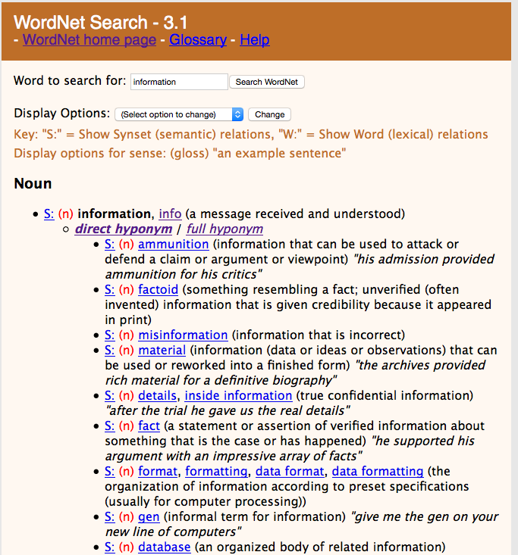
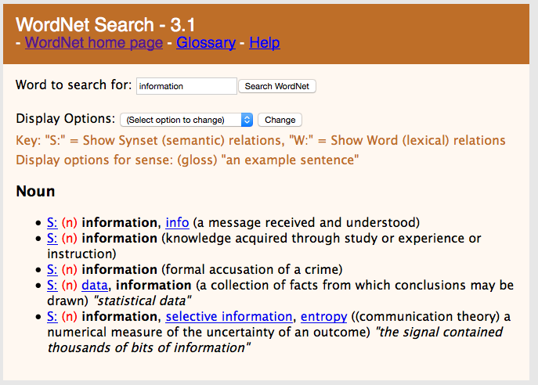
WordNet Example
http://wordnet.princeton.edu/
Notes:
The data of WordNet is publicly available and can be accessed online. It has been used in a variety of projects related to problems sich as query expansion in retrieval, word sense disambiguation or or text classification.

Slide 54
WikiData
Community project to create an open database of structured data
Data curation model like Wikipedia
Intended to support Wikipedia (InfoBoxes)
84 million entities (2020)
Multi-lingual
Both API access and full databases dumps (JSON, RDF)
Notes:
WikiData is a compagnion project of WikiPedia. It aims at creating a universal knowledge graph and is based on the same community approach as WikiPedia. It is used by WikiPedia to provide the InfoBoxes.

Slide 55
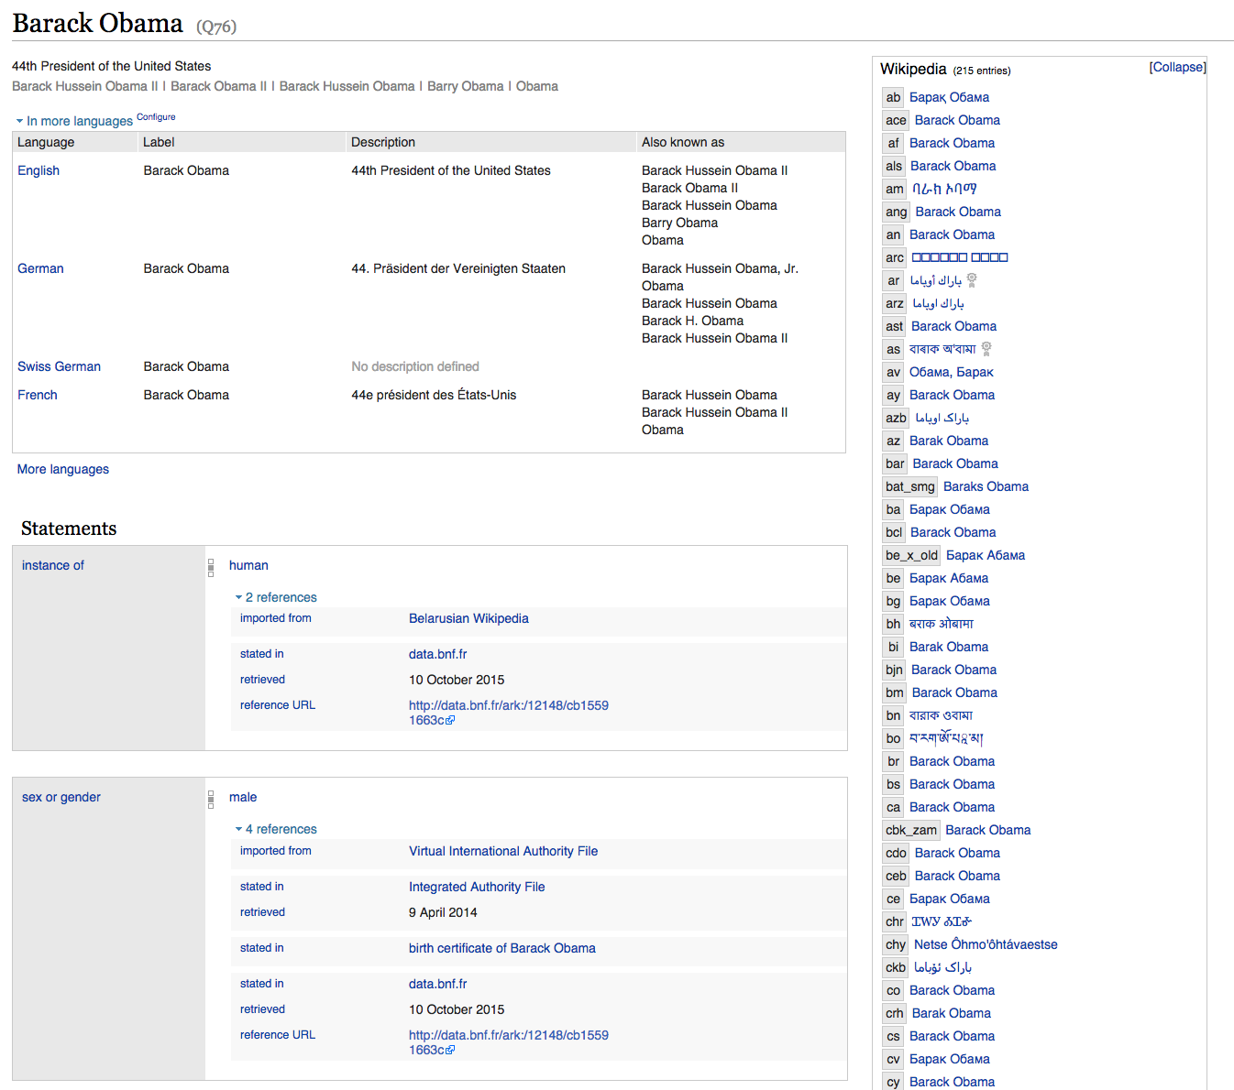
Example WikiData
www.wikidata.org
Notes:
The WikiData project uses (a part of) the RDF model to represent the facts. One interesting aspects is that it correlates the representation of the terms describing an entity or concept across languages.

Slide 56
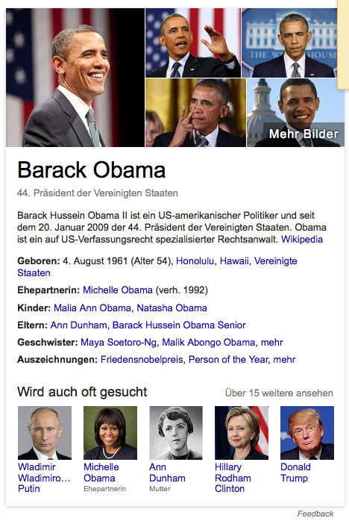
Google Knowledge Graph
Google’s internal knowledge base to support the search engine
Populated from FreeBase and internal data
Enriched with the support of schema.org
Accessible through API
https://www.google.com/intl/es419/insidesearch/features/search/knowledge.html
Notes:
Google has popularized knowledge graphs by the development of its knowledge graph. The project actually started from an earlier community effort called FreeBase. It was then enriched with internal data from Google. It uses schema.org as the underlying data model.

Slide 57
Schema.org
Collaborative, community activity to create, maintain, and promote schemas for structured data on the Internet
Sponsoring companies: Google, Microsoft, Yahoo and Yandex
Two type hierarchies: textual property values, things that they describe
Core vocabulary currently consists of 642 Types, 992 Properties, and 219 Enumeration values
Used by other knowledge bases, e.g., Google Knowledge Graph API, Dbpedia, etc.
Notes:
Schema.org is a generic data model, or knowledge base schema, that has been adopted and promoted by the large Internet platforms. It consists of two hierarchies, one for descibing types of attributes and one for describing types of entites.

Slide 58
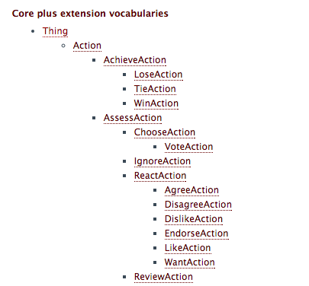
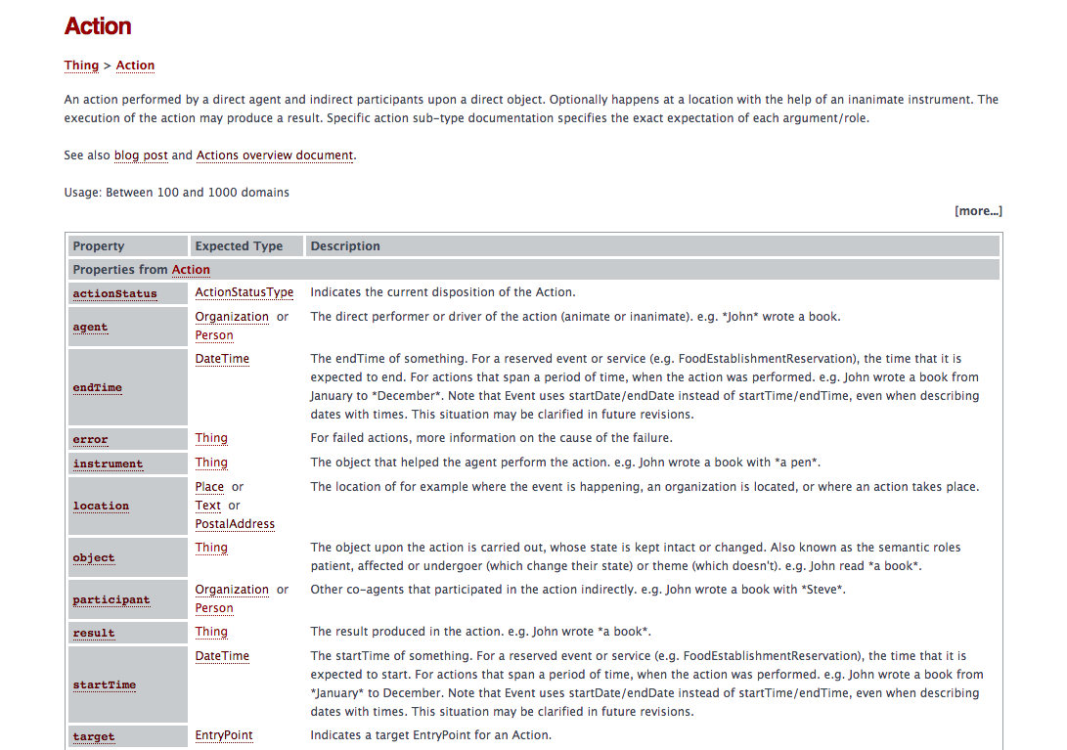
Example
Notes:
This is a sample of schema.org. It is easy to see that the model covers very generic concepts that can be applied to a wide range of applications.

Slide 59
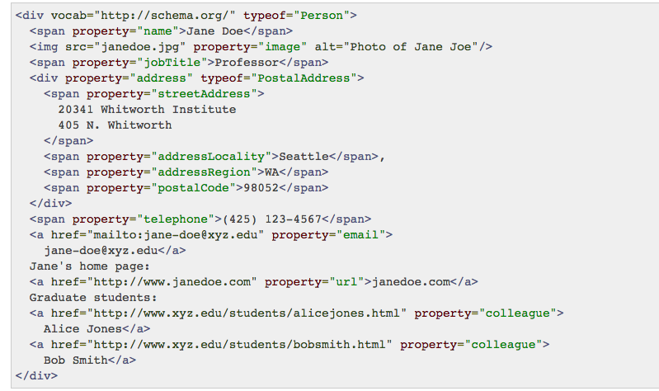
Encoding
Different encodings can be used, JSON, RDFa, Microdata
RDFa: microformat for embedding RDF into HTML
Notes:
Schema.org can be encoded in any of the existing data exchange standards. One specific type of encoding is RDFa. It is used to embed RDF statements into HTML documents in a standardized approach.

Slide 60
Linked Open Data
Repository of open data and knowledge bases and tools
https://www.w3.org/wiki/DataSetRDFDumps
Notes:
Given the rapid adoption of knowledge graphs and the growing number of knowledge bases published, Linked Open Data is an effort to provide an common entry point to a large number of knowledge graph. An interesting aspect in this effort is the fact that knowledge bases often have references among each other. Instead of having isolated knowledge bases, this results in a network of knowledge graphs that is captured and display on the Linked Open Data Website.

Slide 61
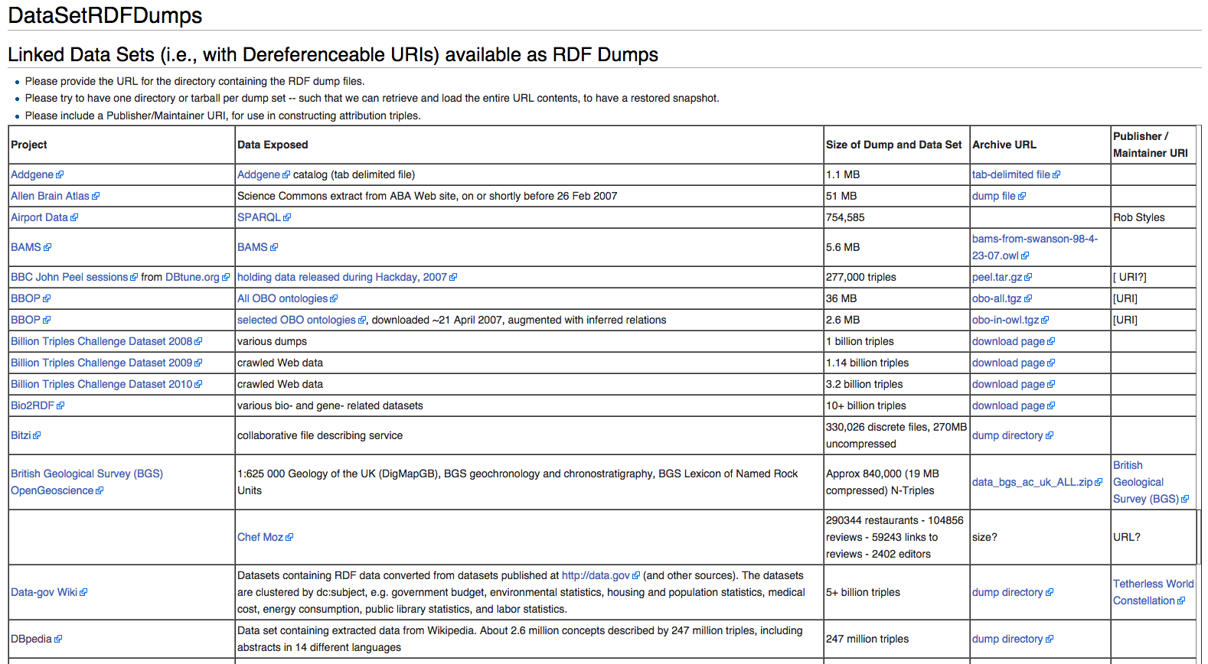
Linked Open Data Example
Notes:
LoD provides a common point of access to obtain a large number of public knowledge bases.

Slide 62
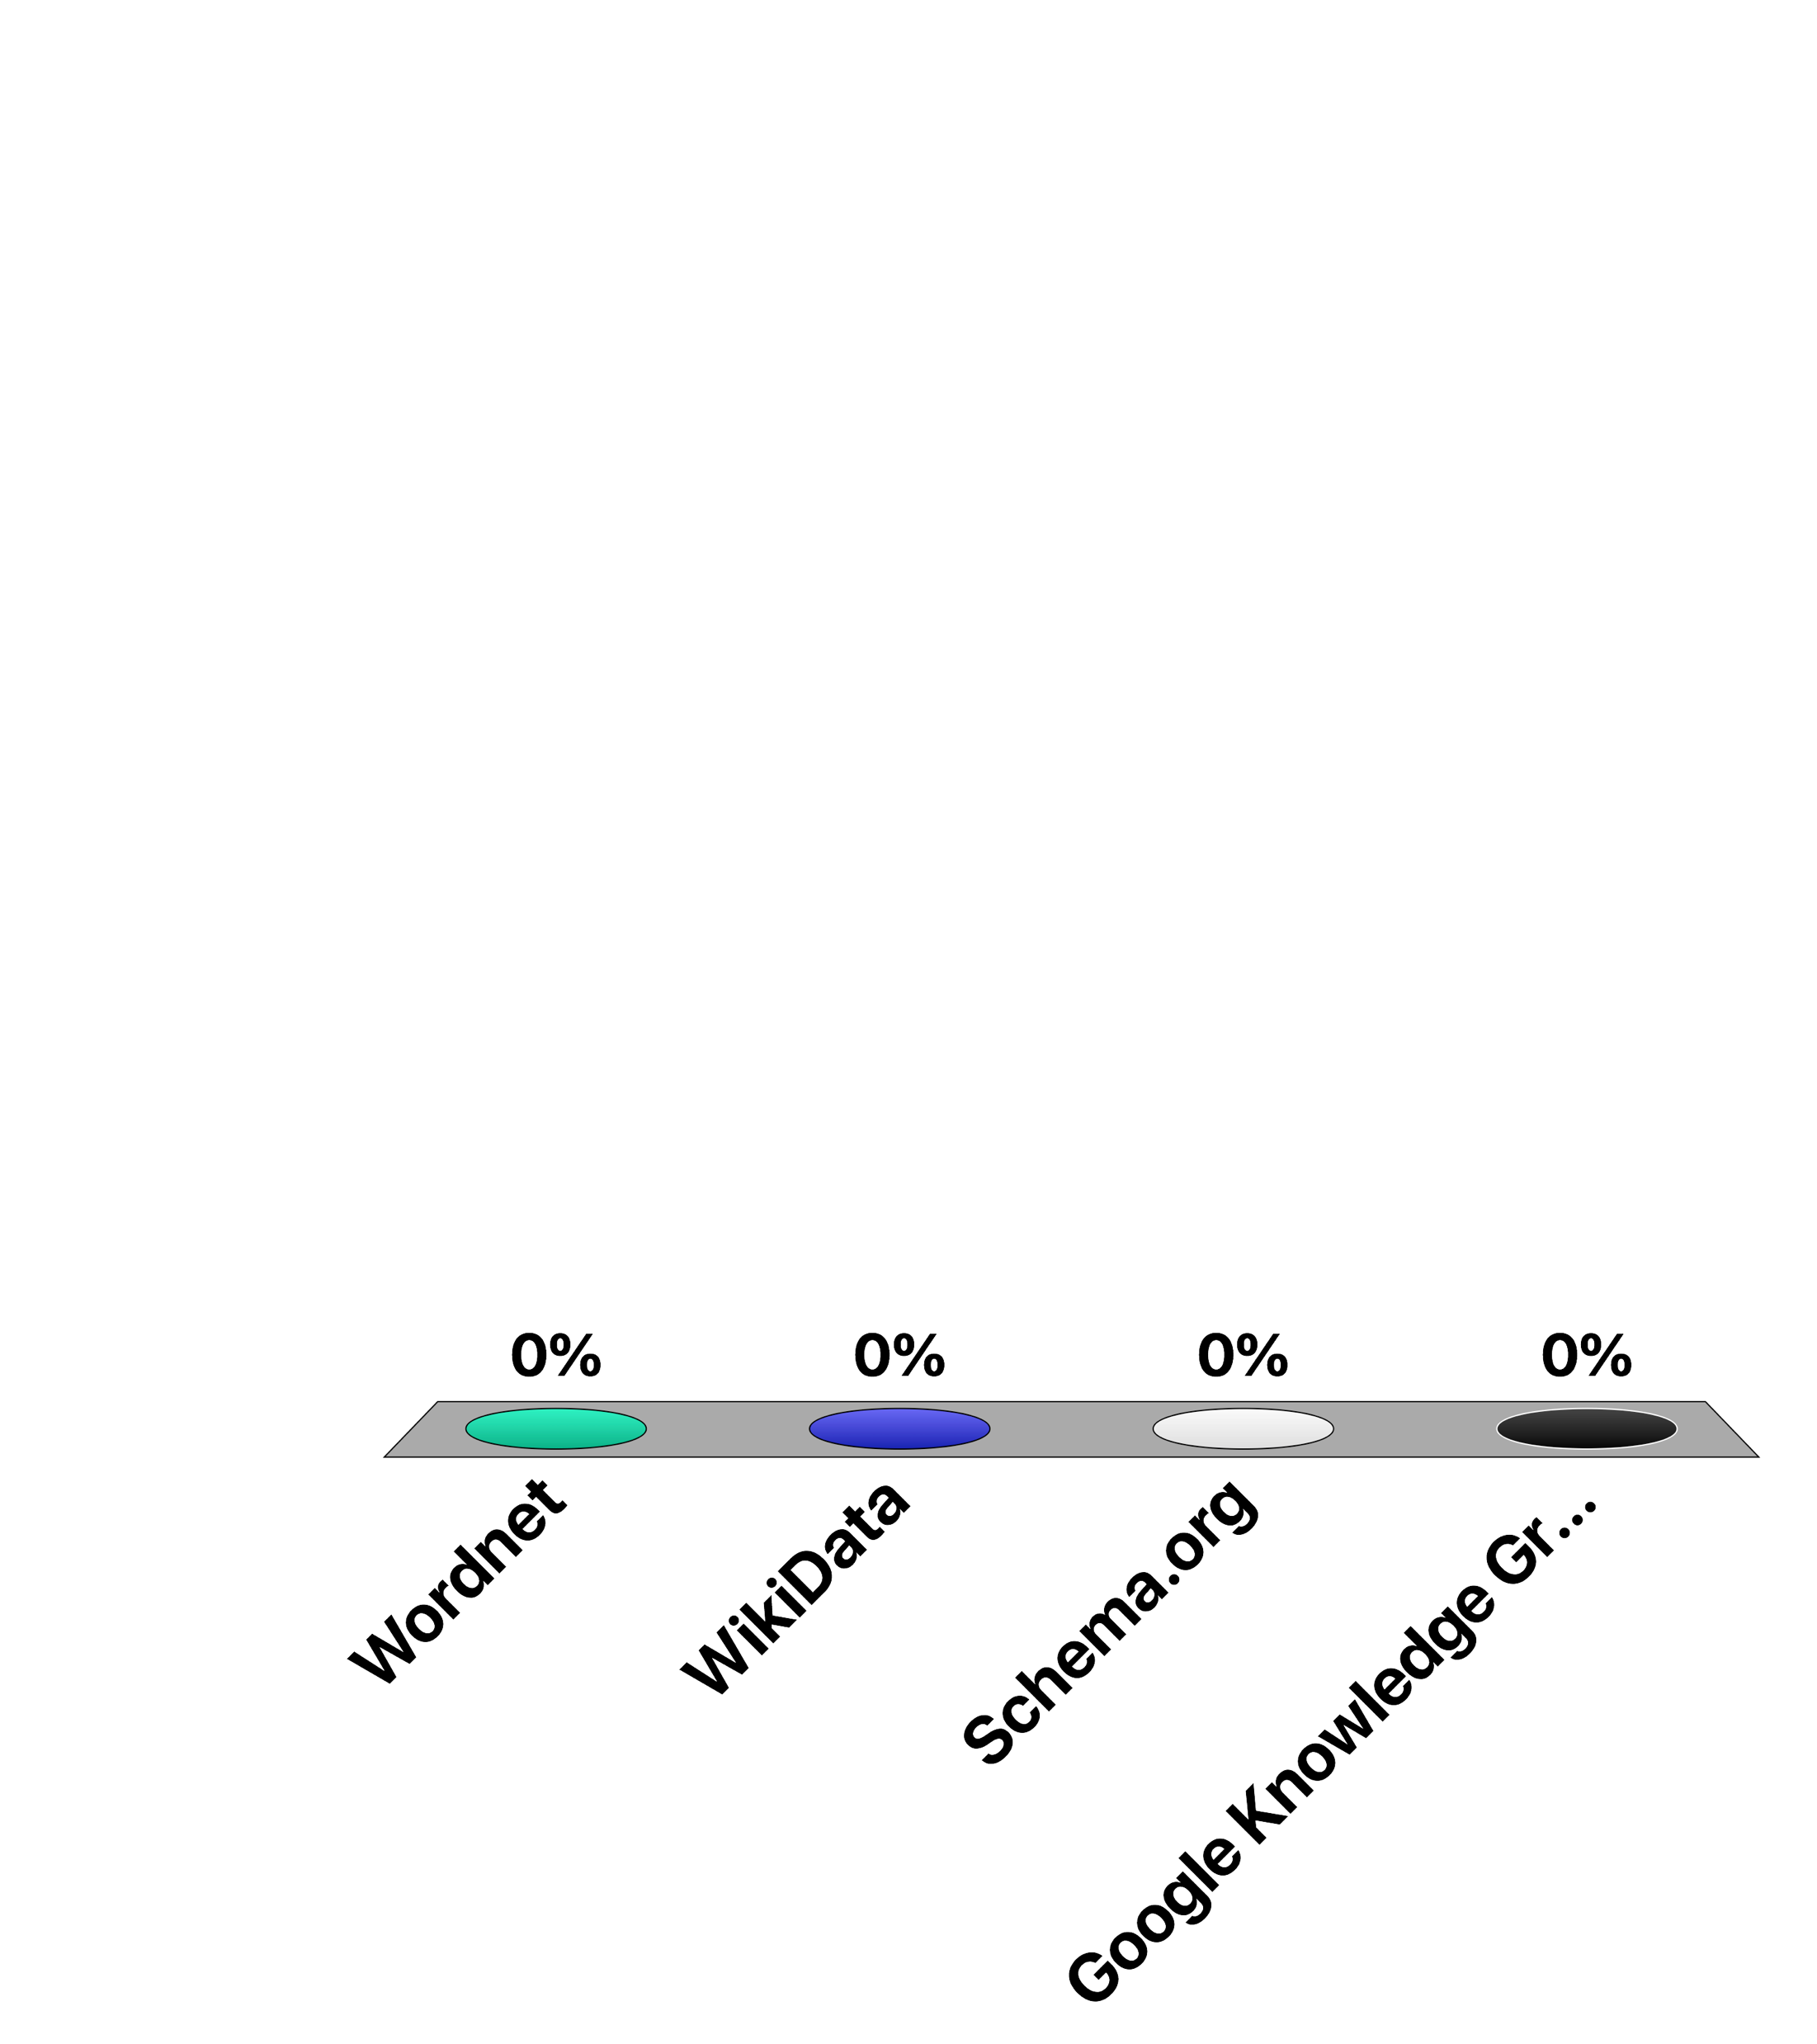
Which of the following is NOT an (instance-level) ontology?
Wordnet
WikiData
Schema.org
Google Knowledge Graph

Slide 63
References
Relevant articles
Grigoris Antoniou, Frank van Harmelen, Semantic Web Primer, MIT Press, 2nd edition, 2004.
Jeen Broekstra, Michel C. A. Klein, Stefan Decker, Dieter Fensel, Frank van Harmelen, Ian Horrocks: Enabling knowledge representation on the Web by extending RDF schema. WWW 2001: 467-478
Stefan Decker, Sergey Melnik, Frank van Harmelen, Dieter Fensel, Michel C. A. Klein, Jeen Broekstra, Michael Erdmann, Ian Horrocks: The Semantic Web: The Roles of XML and RDF. IEEE Internet Computing 4(5): 63-74 (2000)
WebSites
XML, XPath, Xquery, RDF: http://www.w3.org/
OWL: http://www.w3.org/TR/2004/REC-owl-features-20040210/#s1.1

